Slide 1


The daily life of a Polish teen
AKA me!

Slide 2



Waking up
I usually wake up around 7:00, though it really depends on when I go to bed (very late).
I have school at 8:00, so I’m always in a rush!
I pick random clothes that look good enough, hop onto my bike and drive to school for about 8 minutes.

Slide 3



School!
Starts at 8:00
The school expects a lot of attention from you (bad for me)
In the span of 7 hours we have 7 classes, with breaks ranging from 5 to 20 minutes!

Slide 4


Subjects!
I think we need to cut down the list to the subjects I like the most...
The classes we have are:
- Polish language
English language
Spanish/German language
Math
Physics
IT
Biology
Geography
Religion (or Ethics)
Music/Art.
Physical Education
Dancing classes
Native speaker
History
History and Today
Education for Safety

Slide 5




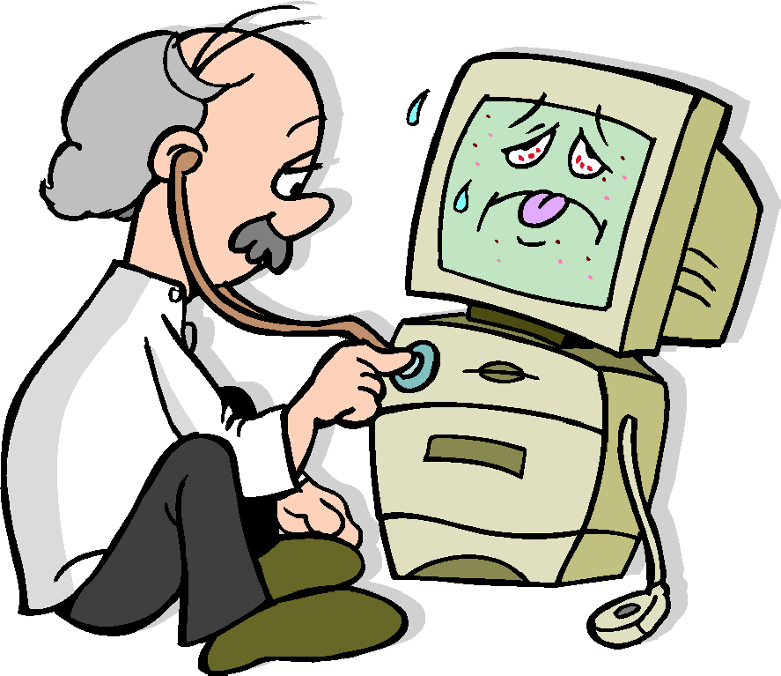

Subjects! (the ones I like the most)
The 3 main subjects I really really love are:

Slide 6

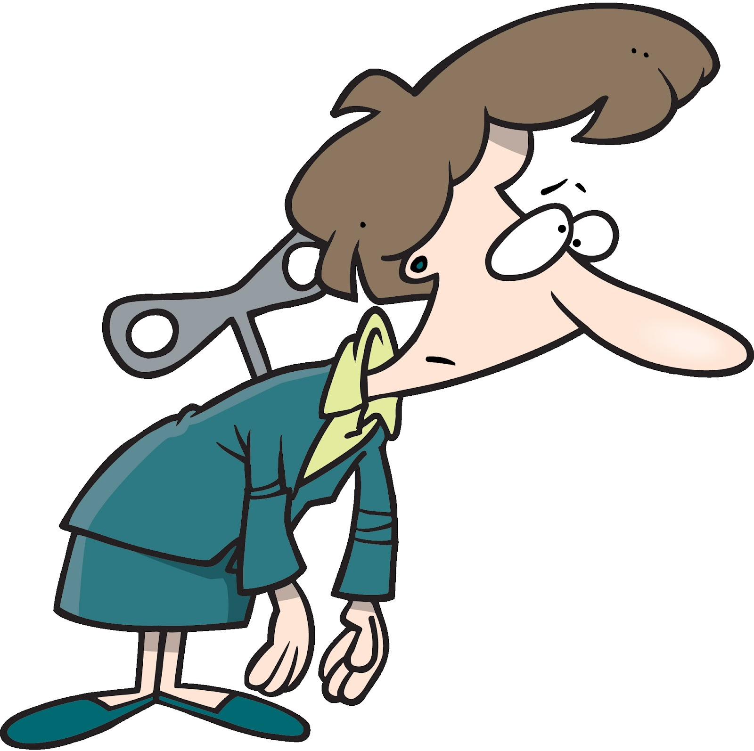

After school
I have a lot of things I do outside of school.
- The side effect of this is that I have to walk a lot between places!

Slide 7
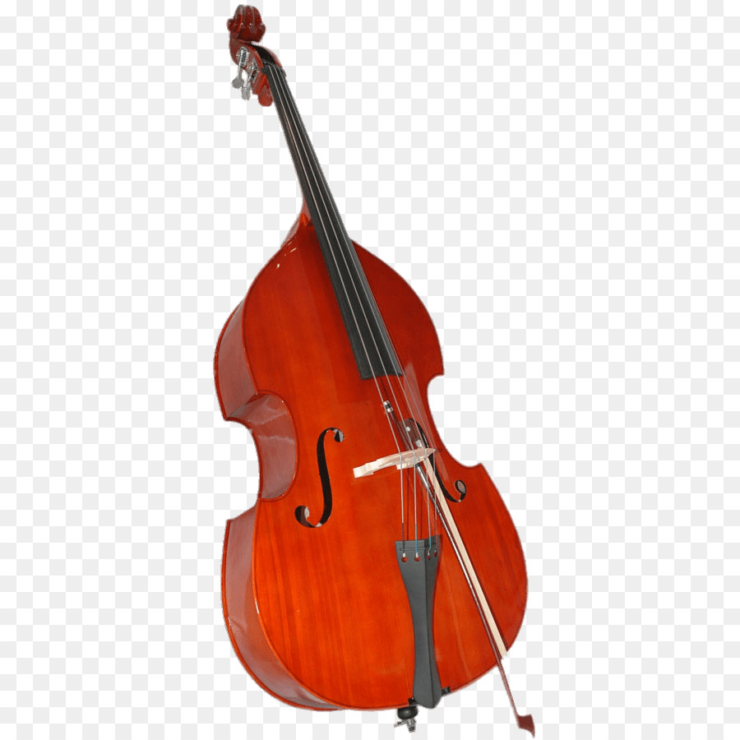


Outside of school…
There are many activities I do outside of school, but the most important ones are:
Going to the gym
SINGING ❤️
Playing the double bass
(it’s taller than me)

Slide 8


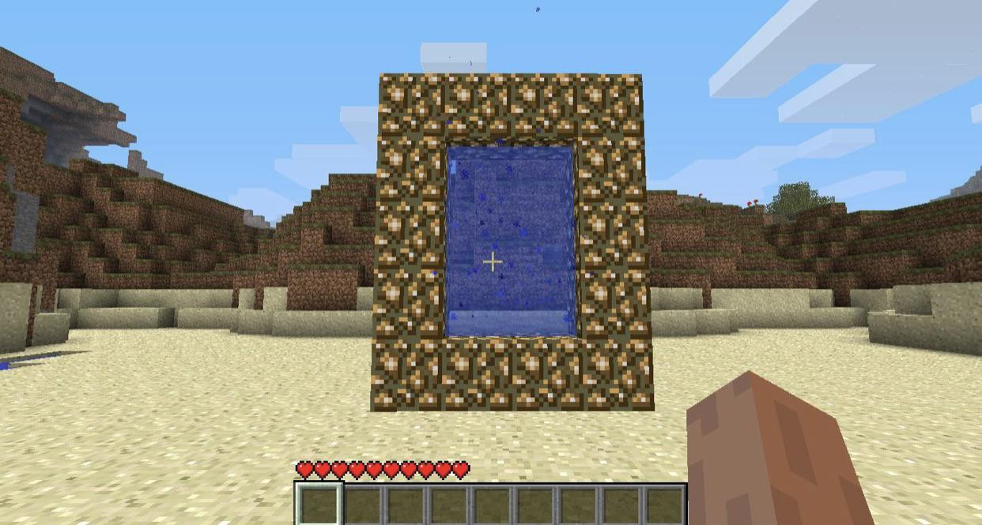
Social life
- our class meets up online on weekends to play harmless games such as:
lego game
trooper game
block game

Slide 9





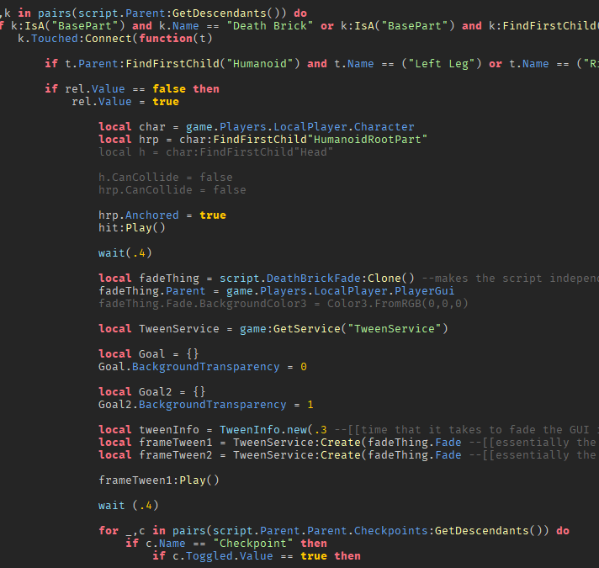
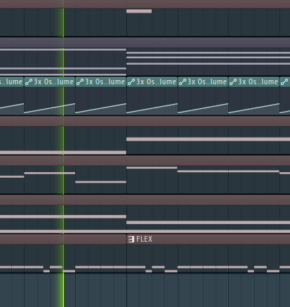


Slide 10

Thank you for your attention.
I hope we’ll meet again soon.

